Slide 1
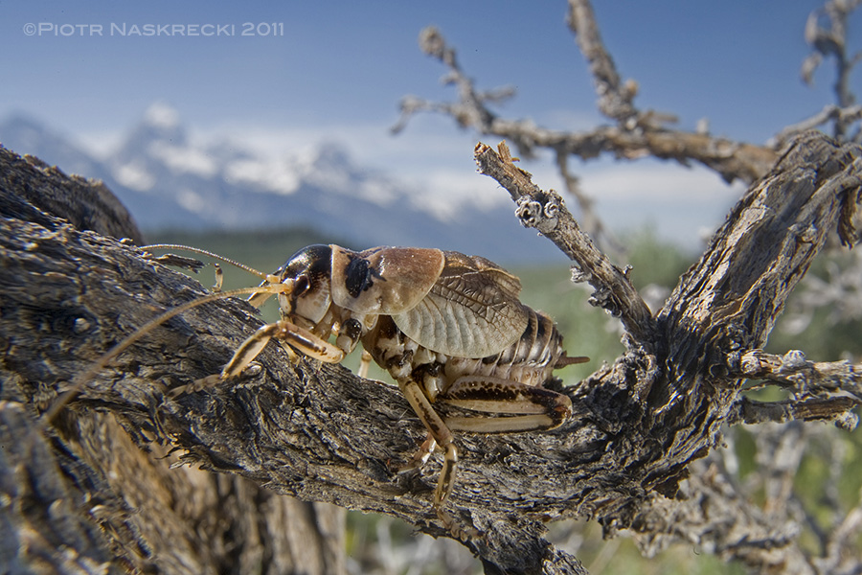
Warmup exercise
Description: Scientists measured the time to mating for female sagebrush crickets, who sometimes conduct sexual cannibalism, that were either fed or starved.
Question: Properly analyze these data using the six step approach.

Slide 2

Description: Scientists wanted to compare phase shifts in the circadian rhythm of melatonin production in participants given alternative light treatments.
Question: Conduct the six step procedure for hypothesis testing for this particular dataset. When selecting the appropriate test to analyse your data (Step 2), please determine whether your data conforms to assumptions of your chosen test. Then after the six steps, plot your data appropriately.

